Slide 1


Movie Recommendation System & Web App
Md. Baker
1911672642
Kazi Kaarima Nashia
2031176642
Fatema Akter Rimi
2021930642

Slide 2
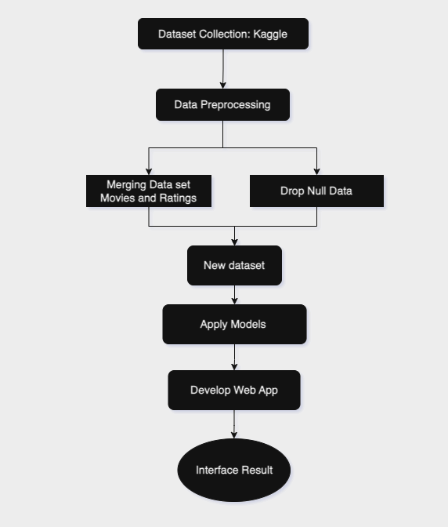
Flowchart
Data Acquisition
Collect a dataset of movies and user ratings.
Preprocess the dataset by cleaning and formatting the data.
Model Training
Choose a machine learning algorithm to train the model.
Train the model on the dataset set.
Model Deployment
Deploy the trained model to a production environment so that it can be used to generate recommendations for users.
Develop a web application to allow users to interact with the model and receive recommendations.

Slide 3
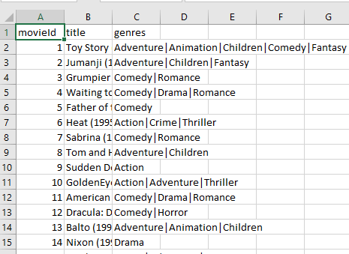
Problem Statement
Aim: Build a movie recommendation system based on ‘MovieLens’ dataset.
DataSet
‘MovieLens’ dataset (ml-latest-small)
Ratings: 100k
Movies: 9.8k
Users: 600

Slide 4
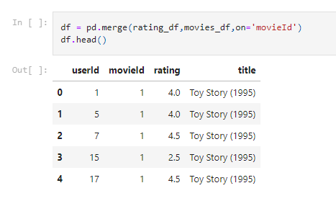
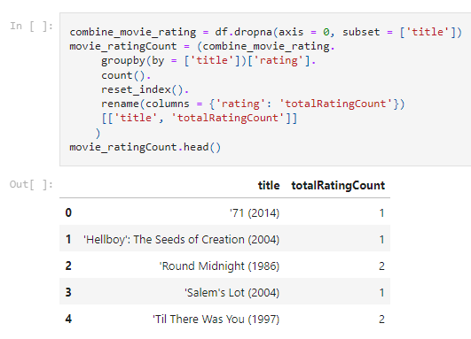
Data Preprocessing

Slide 5
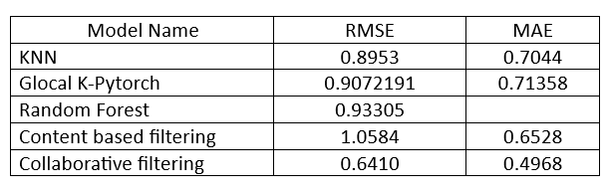
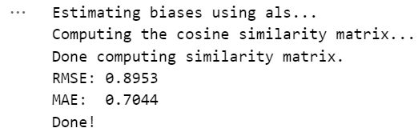
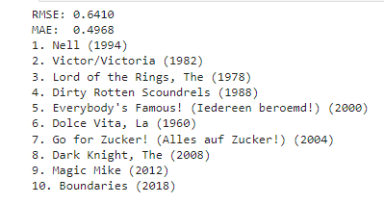

Models Results

Slide 6
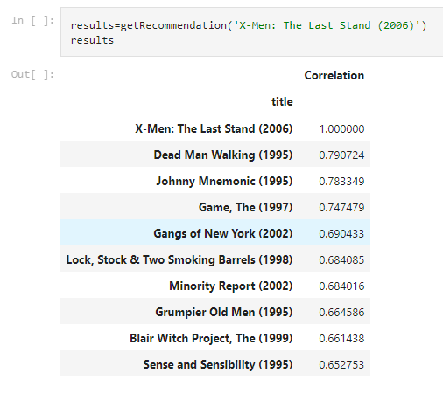
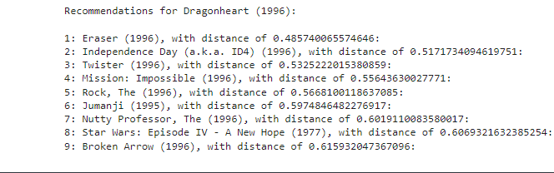
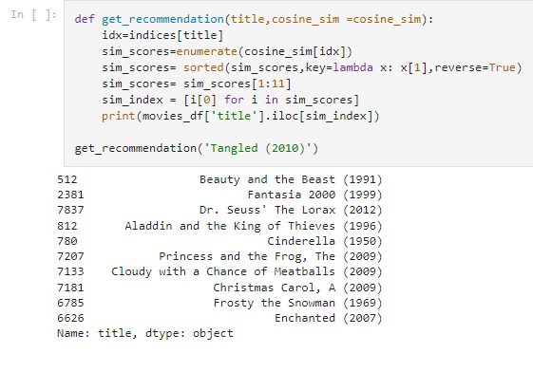
Models Results
Collaborative Filtering
Content-Based Filtering
KNN

Slide 7
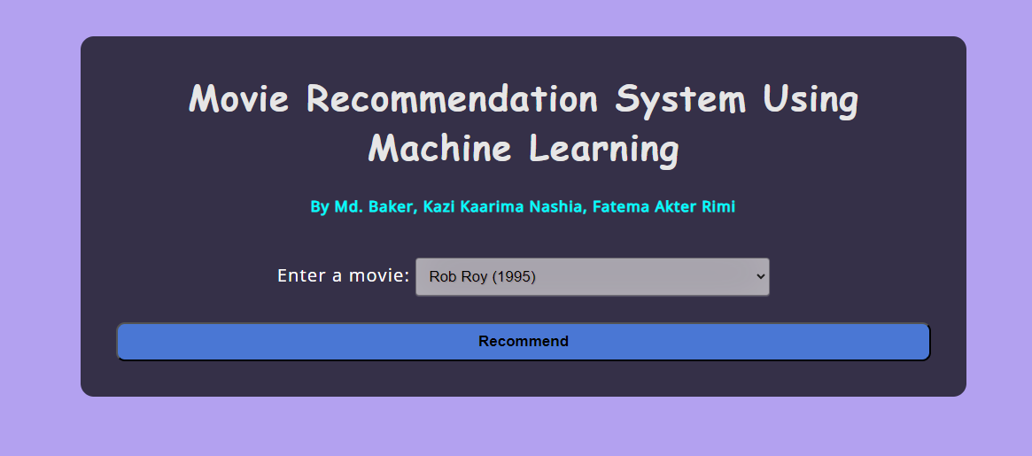
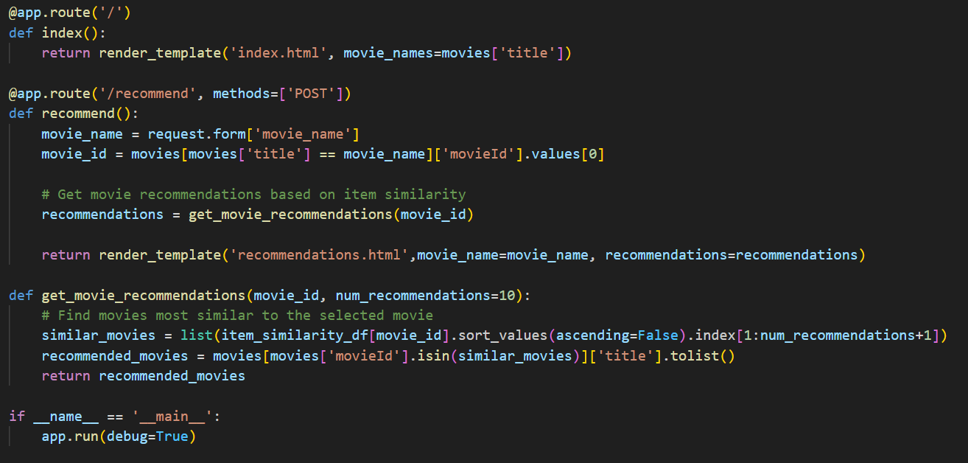
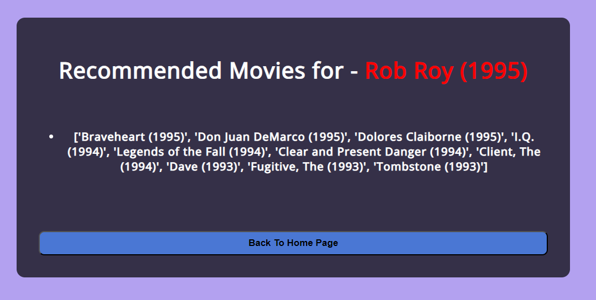
Web App

Slide 8
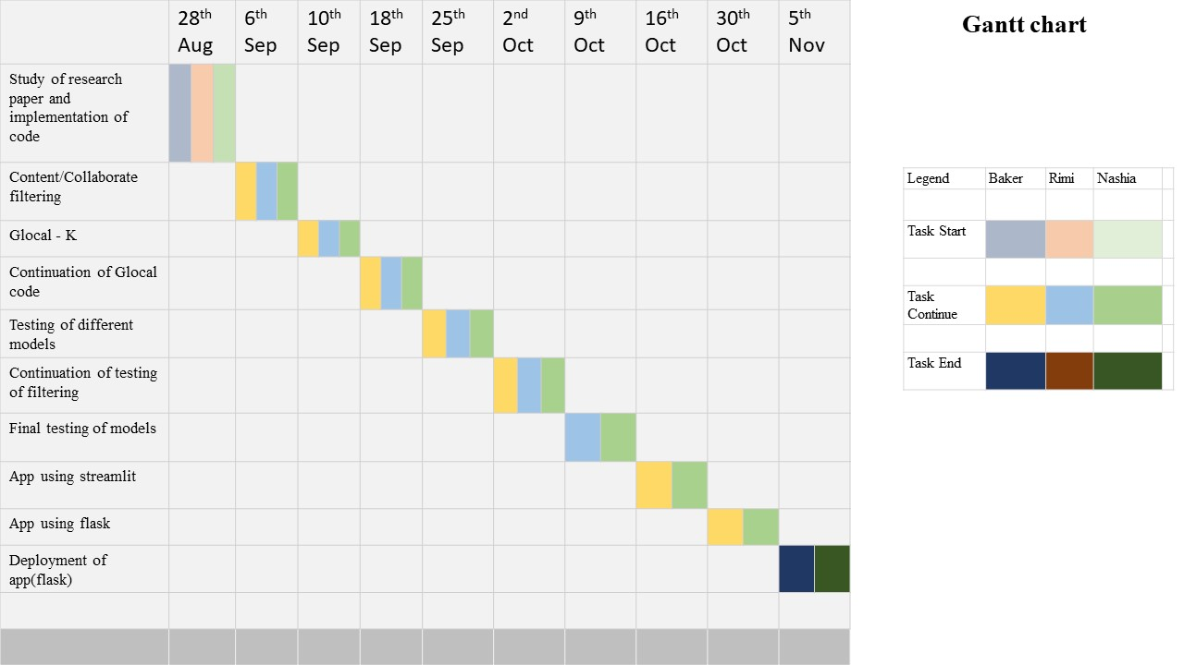
Gant Chart

